Slide 1
Management 830 Midterm Exam
Jason Messner

Slide 2
Introduction
Jason Messner- Lead Data Analyst
Background: Two entrepreneurs, Bex and Sparks, have assigned a data analyst the task of identifying the ideal area for a new business pursuit in the farming sector. The task involves choosing between the areas of Riley County, KS and Chippewa County, MI using the availability of federal grant money and existing demographic characteristics as leading determining factors.
Resources: US Census Dataset and US Farm Service Agency Aid Dataset
Guidelines: Screen shot of data model, Word document with visuals, professionally labeled/rounded with interactive visuals/color and avoidance of clutter.

Slide 3
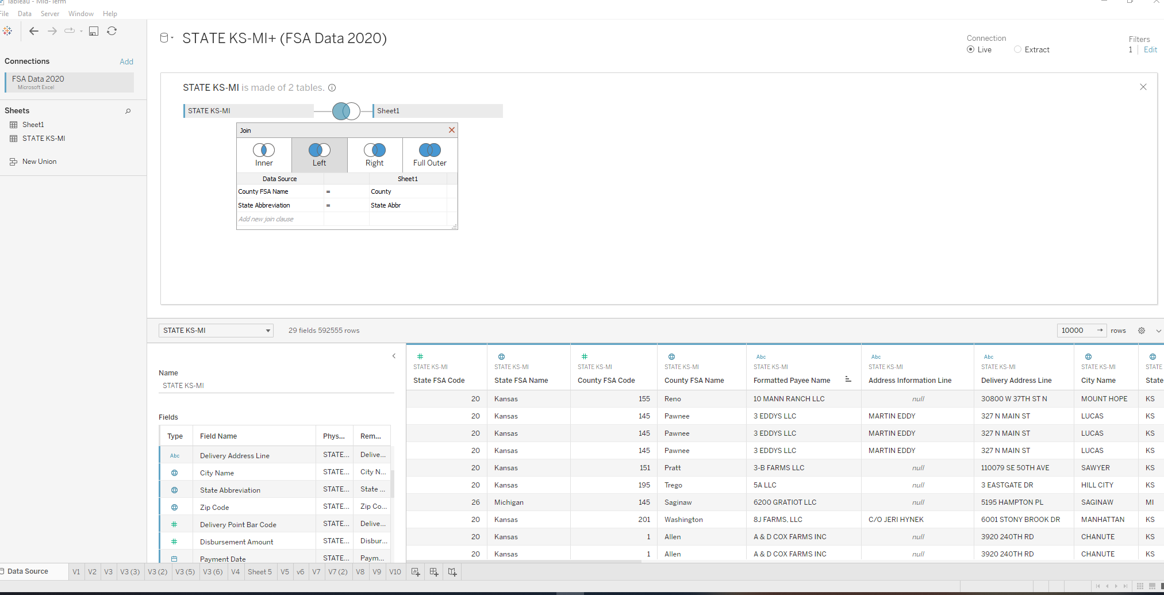
Data Model-Left Join

Slide 4
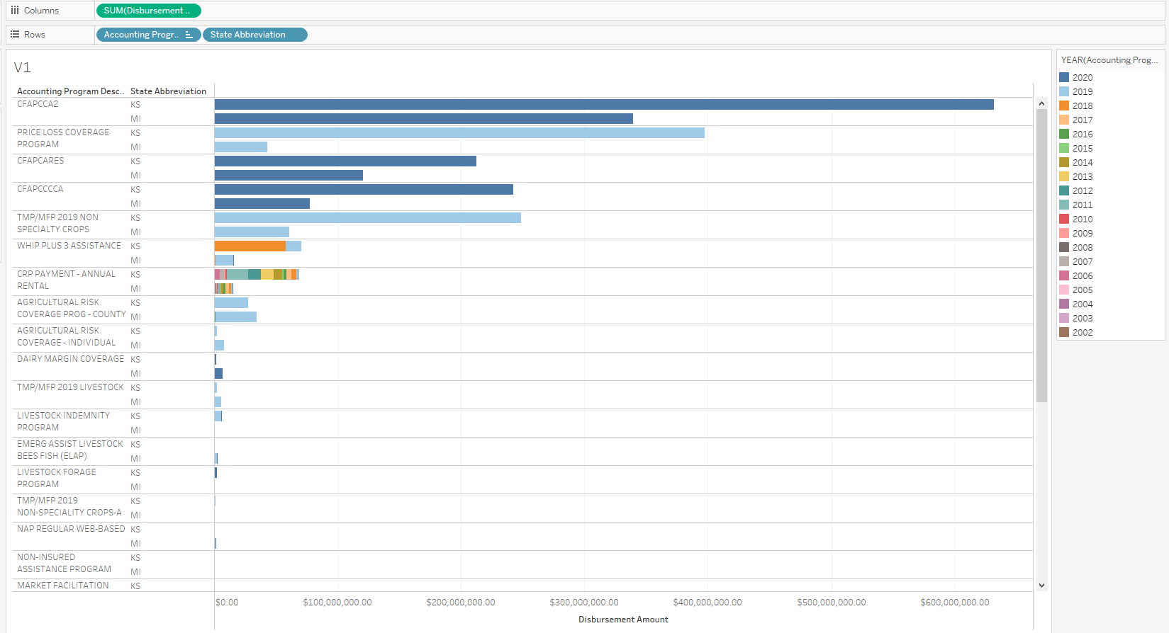
Visual #1
This first visual shows a noticeable difference and trend in the amount of federal grant aid both states have received since 2018. Of note, not all Accounting Programs are shown as a number had negligible amounts.
Additionally, all grants beginning with CFA are covid related. Price Loss coverage program and TMP/MFP 2019 NON Specialty Crops give out the most money when covid grant money is excluded.

Slide 5
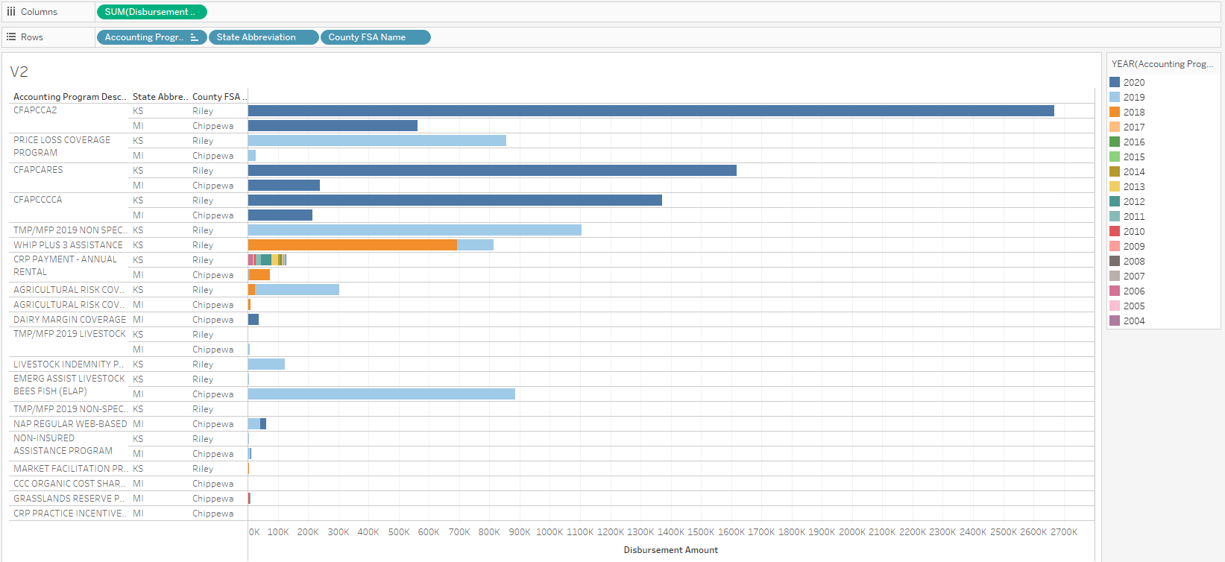
Visual #2
This visual goes a step further and breaks down the grant aid by county.
Riley County continuing with the overall KS trend has received almost double the amount of aid that Chippewa County Did since 2018.

Slide 6
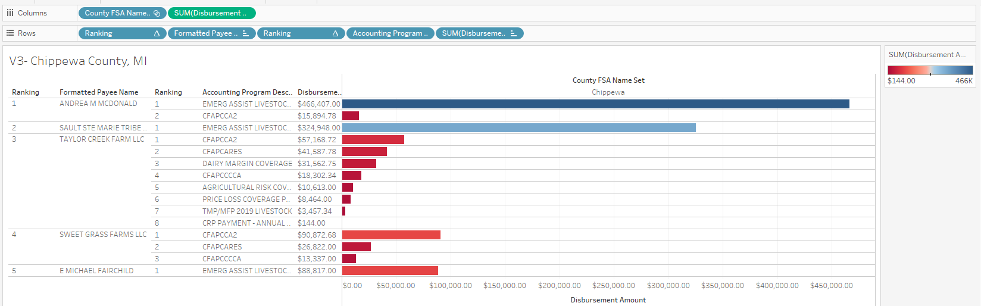
Visual #3-Chippewa County, MI
This visual shows the top 5 payees in Chippewa County and breaks down into which grants gave them the most money. The covid grant money is noticeably one of the top donors.

Slide 7
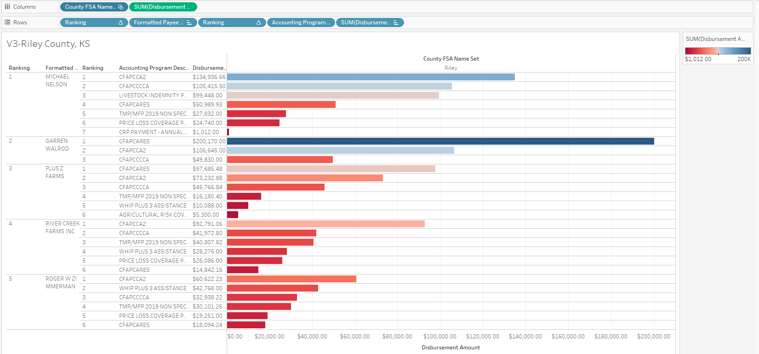
Visual #3-Riley County, KS
This is a repeat of the visual previously shown but of Riley County, KS. This county has noticeably larger payees with the covid grants staying at the top again in terms of amounts.

Slide 8
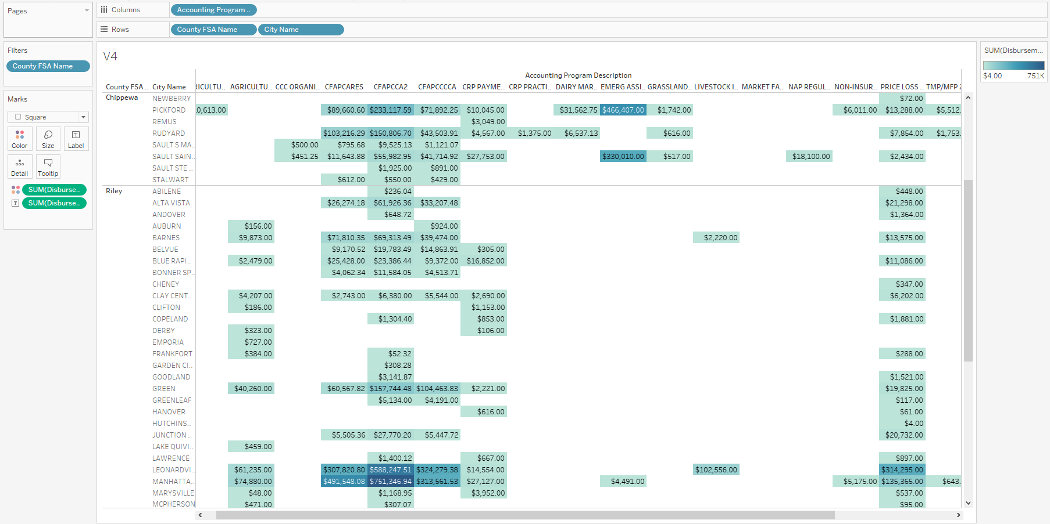
Visual #4
This is a highlight tables showing cities by county with Accounting program description as columns. The data is the amount in dollars given per accounting program. This is a large table, and the most notable figures are shown between Chippewa and Riley. Riley has a noticeably larger overall amount of grant money per city per program compared to Chippewa.
Larger cities noticeably receive larger quantities of grant money across the board.

Slide 9
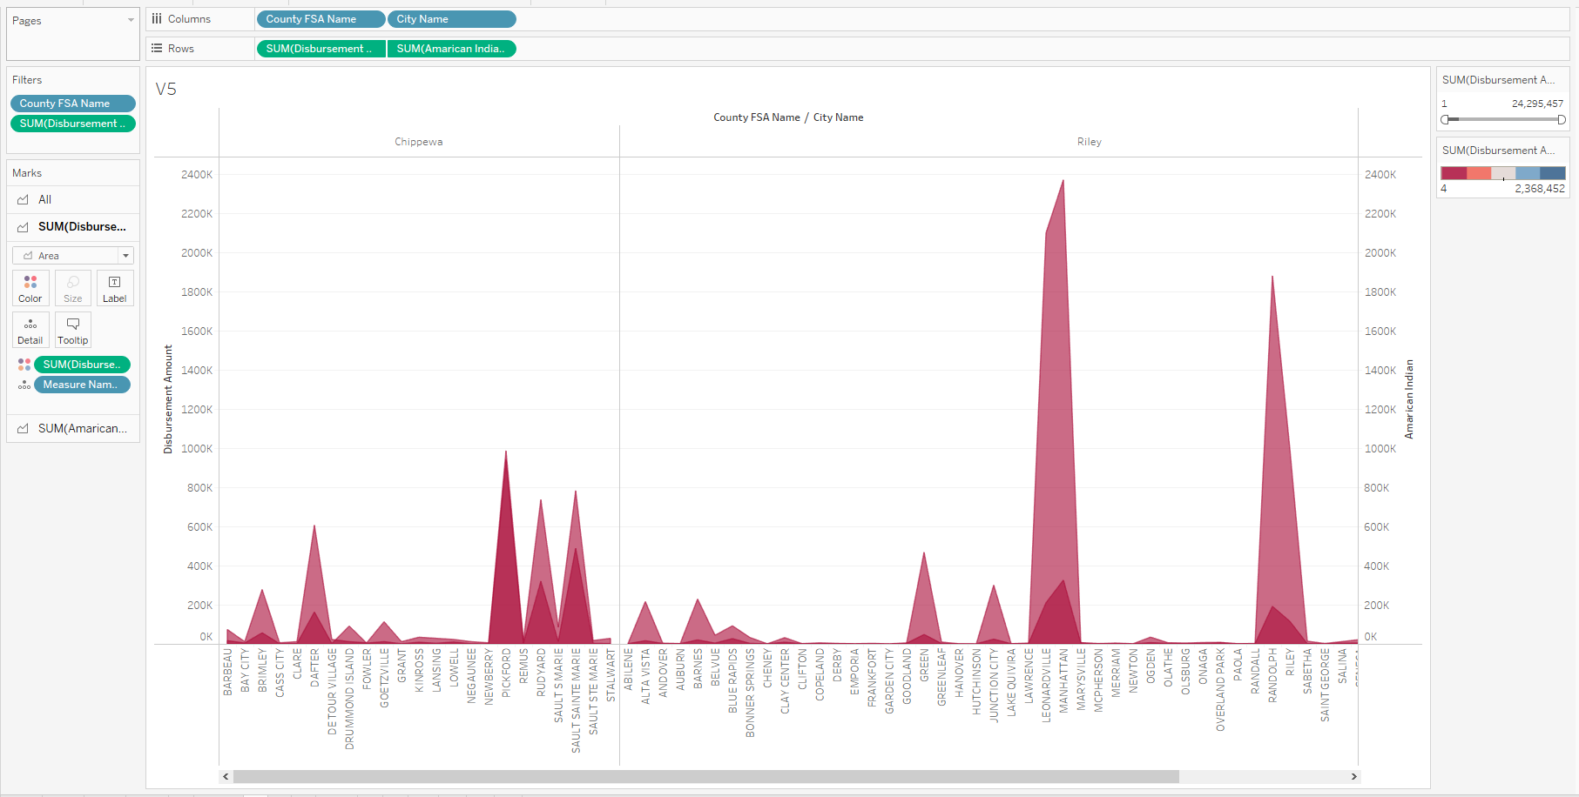
Visual #5
This graph shows a clear increase in grant money where there are larger communities of Native Americans in both counties. It appears that even though Chippewa, MI likely has more populated Native American areas, Riley County appears to see a much larger increase in funding where Native Americans are congregated.

Slide 10
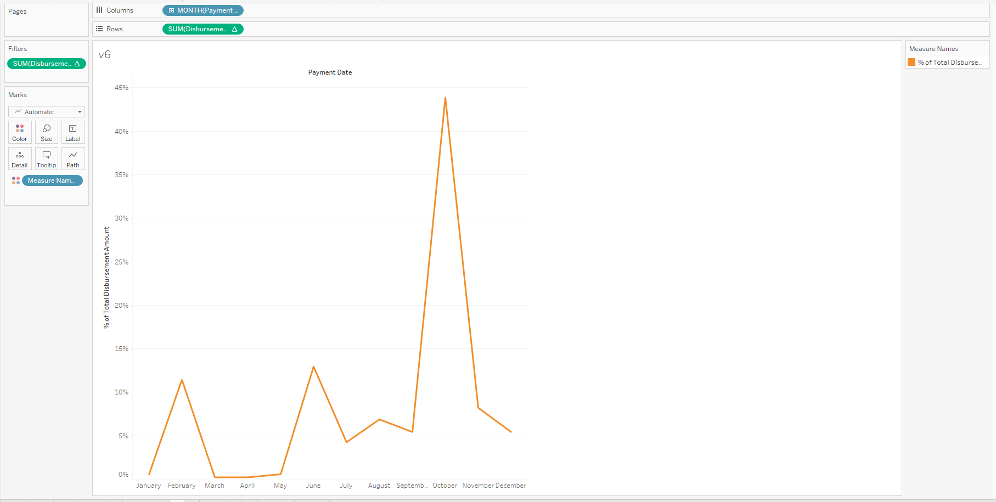
Visual #6
This visual shows that there is a seasonal if not monthly time component to when grant money is dispersed. 43.87% of all funding was dispersed in October of 2020.

Slide 11
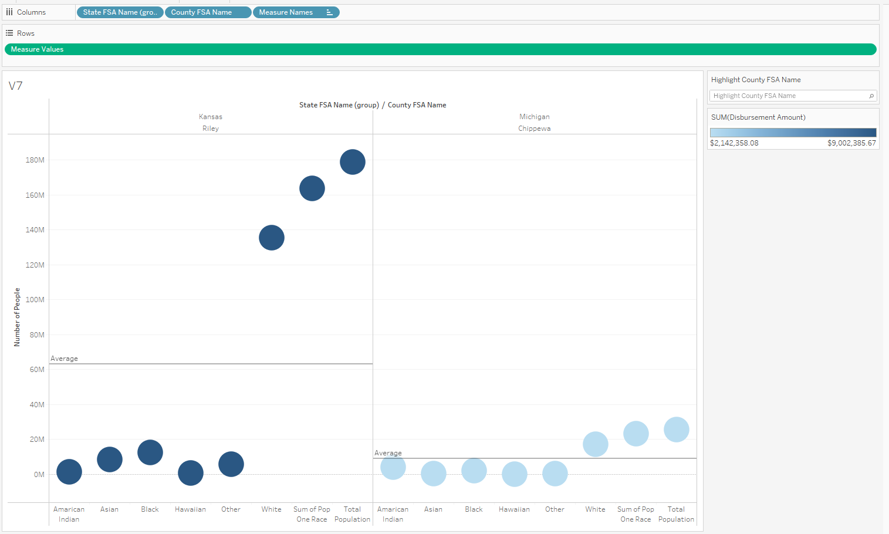
Visual #7
This graph shows a clear distinction between Riley and Chippewa in terms of overall population numbers and disbursement received.
Chippewa is more diverse going from overall percentages/ratio of minorities compared to majority ethnicities, but Riley still receives quite a bit more grant money.
Kansas appears to have more mixed ethnicities compared to Michigan.

Slide 12
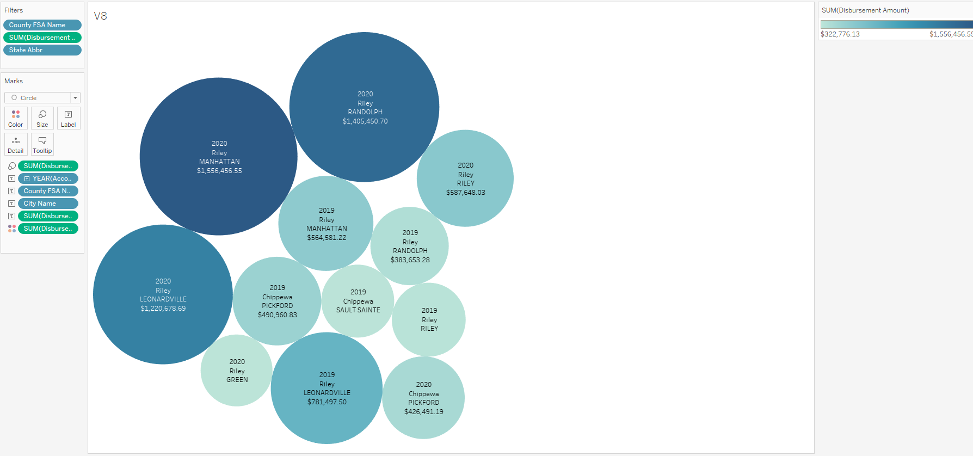
Visual #8
This visual shows that there is a distinct difference in amounts received between Riley County, KS towns and Chippewa, MI towns.
In order to make the visual work, values cities receiving under $322,776 dollars were excluded.

Slide 13
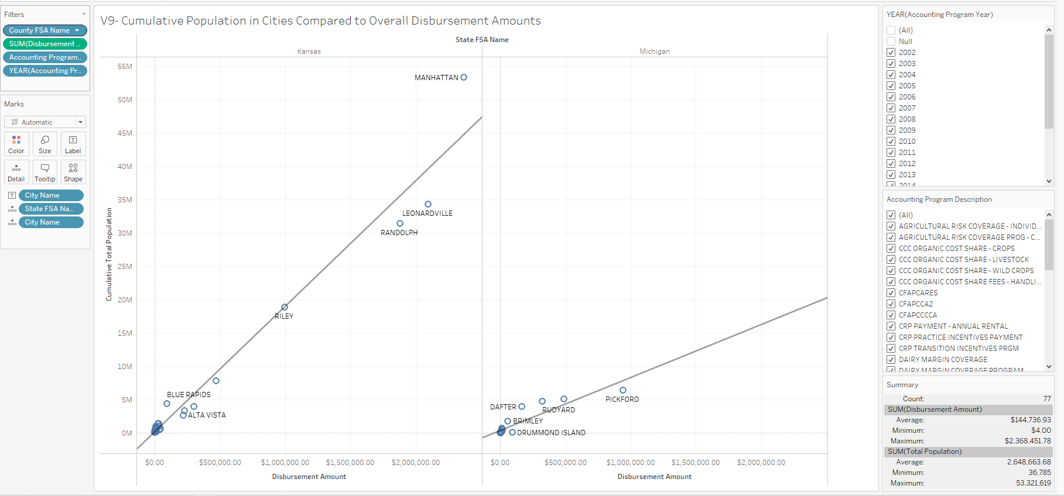
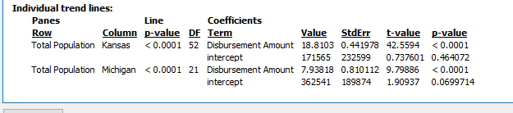
Visual #9
There is a clear correlation between cumulative total population and dispersed grant money especially seen when more populous Kansas towns are compared to Michigan towns.

Slide 14
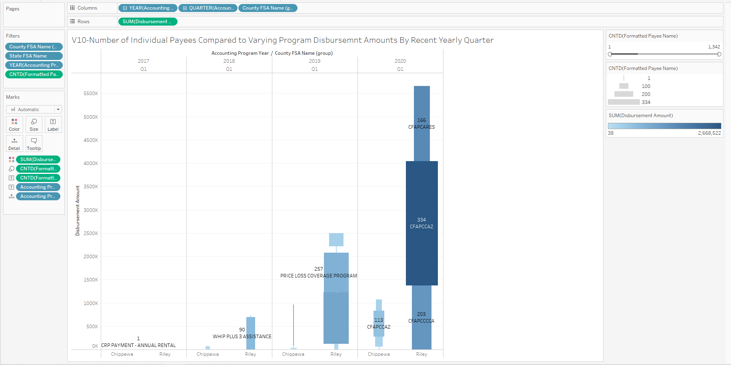
Visual #10
This visual illustrates the key ideas that the majority of grant money has been from Covid grants and the rest of the grant sum has been small in comparison. The amount of money has increased significantly since 2017. Ideally, entrepreneurs will want to identify a program that has the least number of payees with the highest amount of grant money dispersed ie the darkest blue color with the smallest count of payees or thinnest line segment.

Slide 15
Conclusions
The data shows that overall, Riley County, KS is much more efficient and effective at attracting and receiving grant money. Areas that are high in diversity whether in Michigan or Kansas do receive larger amounts of grant money versus less diverse areas. Kansas receives more grant money for its diversity than Michigan does.
Another finding was that if a business venture occurs, then that venture should get the necessary paperwork in to apply for grant money by October when most of the grant money appears to be handed out.
It is also noted that more research needs to be done regarding specific grants. It appears that not all payees qualify for all the same grants. Ideally, the client would want to qualify for a grant that pays a lot and that most payees do not qualify for. It also seems that a few individuals in both counties receive most of the grant money so more research into how they make this occur would be fruitful.
The final observation is that this entire grant situation is likely fluid. Most of the grant money comes from Covid-related grants which are likely to eventually expire and not be renewed as Covid runs its course. It does appear that Kansas and specifically Riley County, KS is overall more efficient and effective at attracting grant money whether it be covid or non-covid related so Kansas is still likely still the best bet for a farming business venture.

